Slide 1

GRAPH THEORY AND ITS APPLICATIONS
Dr. Arti Arya
Department of Computer Science & Engineering

Slide 2
GRAPH THEORY AND ITS APPLICATIONS
Graph Coloring
Dr. Arti Arya
Department of Computer Science & Engineering

Slide 3

Graph Theory and its Applications Disclaimer
The slides are prepared by Dr. Surabhi Narayan and a lot of content is added by Dr. Arti Arya. The sources of the information other than text book is mentioned wherever used.

Slide 4
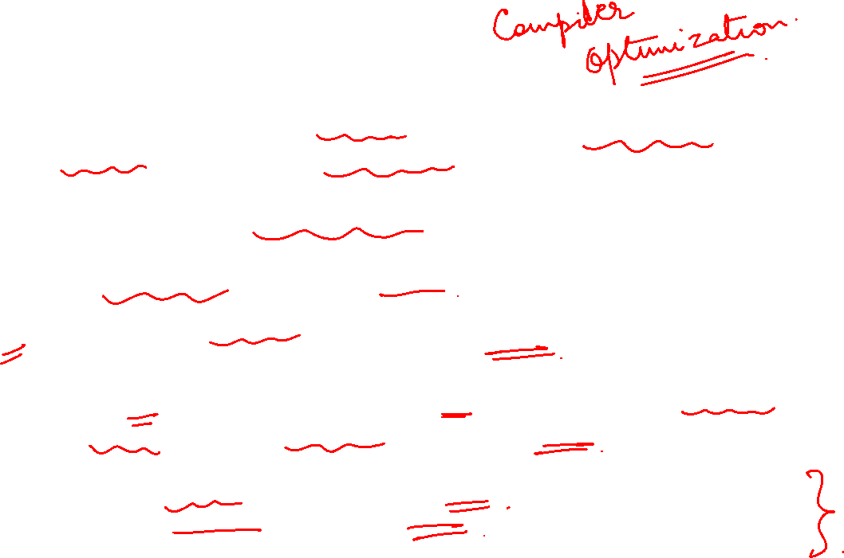
Graph Theory and its Applications
Register Allocation using Graph Coloring
Registers serve as a quick memory for accepting , storing and sending data and instructions that the CPU will need right away.
Registers are basically collection of flip-flops.
Smallest data handling elements that are built into the processors itself.
These are the memory locations directly accessible by the processor.
Register Allocation is a process of identifying which value should be placed in what register and at what time during the execution of the code.
In compiler optimization, register allocation is the process of assigning local automatic variables and expression results to a limited number of processor registers.

Slide 5
Graph Theory and its Applications
Register Allocation using Graph Coloring
Graph coloring is a simple systematic technique for allocating registers and managing Register Spills.
Spills: Storing the register content in a variable means Register Spill to make Register available.
Register Spills are costly so we avoid register spills in between the execution of the code.

Slide 6
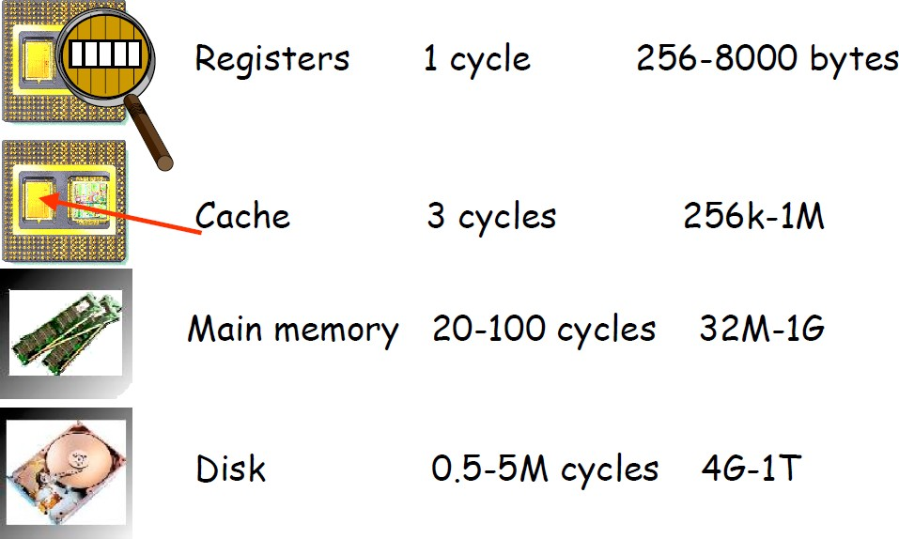
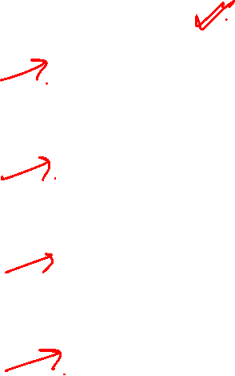
Graph Theory and its Applications Register Allocation using Graph Coloring
Memory Hierarchy
https://web.cecs.pdx.edu/~mperkows/temp/register-allocation.pdf

Slide 7
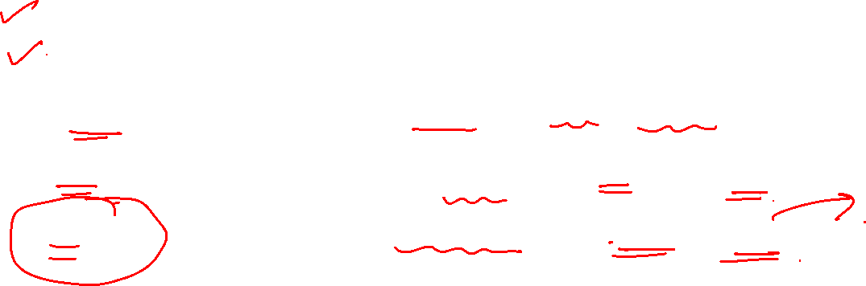
Graph Theory and its Applications Register Allocation using Graph Coloring
Memory Hierarchy
Programs are written as if there are only two kinds of memory:
Main Memory
Disk Memory
Programmer is responsible for moving data from disk to memory (e.g., file I/O)
Hardware is responsible for moving data between memory and caches
Compiler is responsible for moving data between memory and registers
https://web.cecs.pdx.edu/~mperkows/temp/register-allocation.pdf

Slide 8
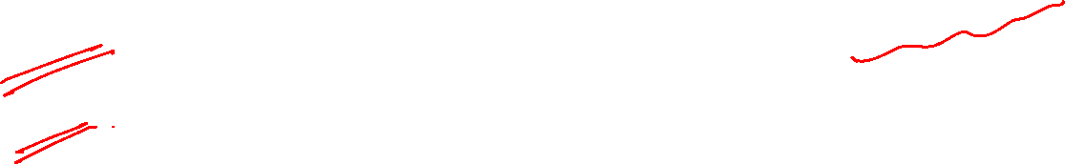
Graph Theory and its Applications Register Allocation using Graph Coloring
Cache and register sizes are growing slowly
Processor speed improves faster than memory speed and disk speed
– The cost of a cache miss is growing
– The widening gap is bridged with more caches
• It is very important to:
– Manage registers properly
– Manage caches properly
Compilers are good at managing registers
https://web.cecs.pdx.edu/~mperkows/temp/register-allocation.pdf

Slide 9

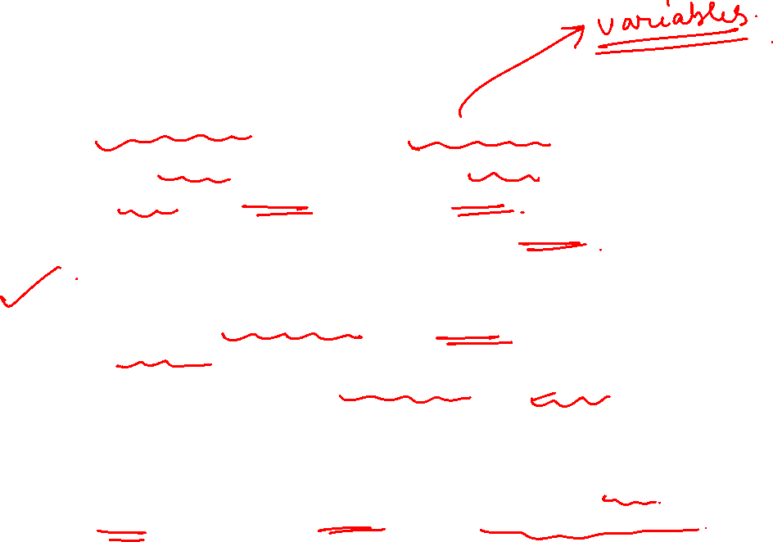
Graph Theory and its Applications
Register Allocation Problem using Graph Coloring
Intermediate code uses as many temporaries as needed.
But This complicates final translation to Assembly.
But simplifies code generation and optimization
Typical intermediate code uses too many temporaries.
The Register Allocation Problem:
Rewrite the intermediate code to use lesser temporaries than there are registers
Method to do so: Assign more temporaries to a register but the program behviour must not change.
Register allocation was used in the FORTRAN complier in 1950s
Chaitin implemented Register Allocation using Graph Coloring in 1980s
https://web.cecs.pdx.edu/~mperkows/temp/register-allocation.pdf

Slide 10
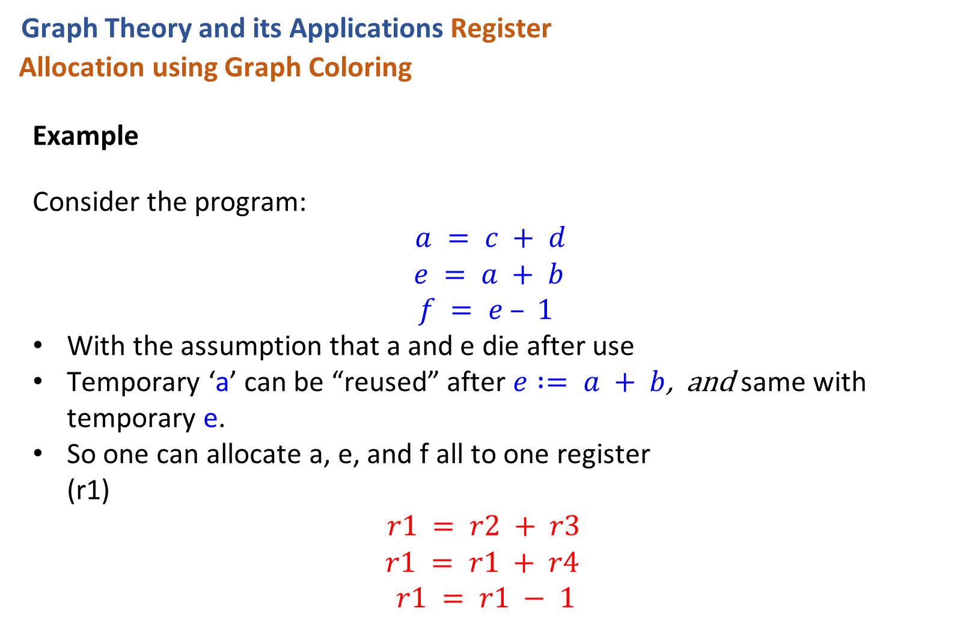
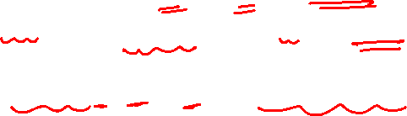
Graph Theory and its Applications Register Allocation using Graph Coloring
Example
Consider the program:
$a = c + d$
$$e = a + b$$
$$f = e – 1$$
With the assumption that a and e die after use
Temporary ‘a’ can be “reused” after $e := a + b$, and same with temporary e.
So one can allocate a, e, and f all to one register (r1)
$r1 = r2 + r3$
$$r1 = r1 + r4$$
$$r1 = r1 − 1$$

Slide 11
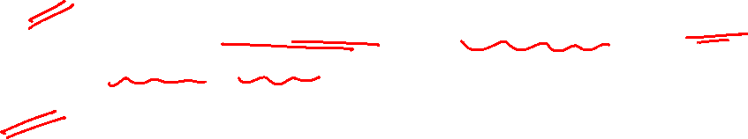
Graph Theory and its Applications
Register Allocation using Graph Coloring
Basic Register Allocation Idea
The value in a dead temporary is not needed for the rest of the computation and hence can be reused.
Basic rule:
Temporaries t1 and t2 can share the same register if at any point in the program at most one of t1 or t2 is live !

Slide 12
Graph Theory and its Applications
Register Allocation using Graph Coloring
L1: a:=b+c
d:=-a
e:=d+f
If( expression) then
f:=2*e
else
b:=d+e
e:=e-1
endif
b:=f+c
go to L1
……….
…………

Slide 13
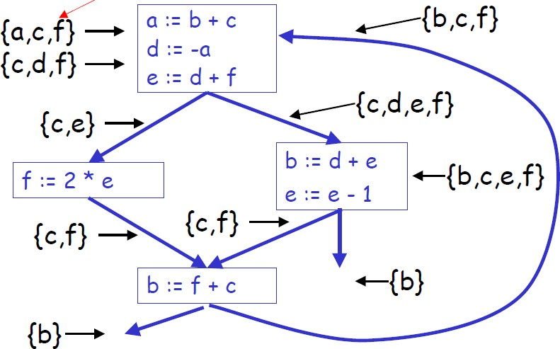
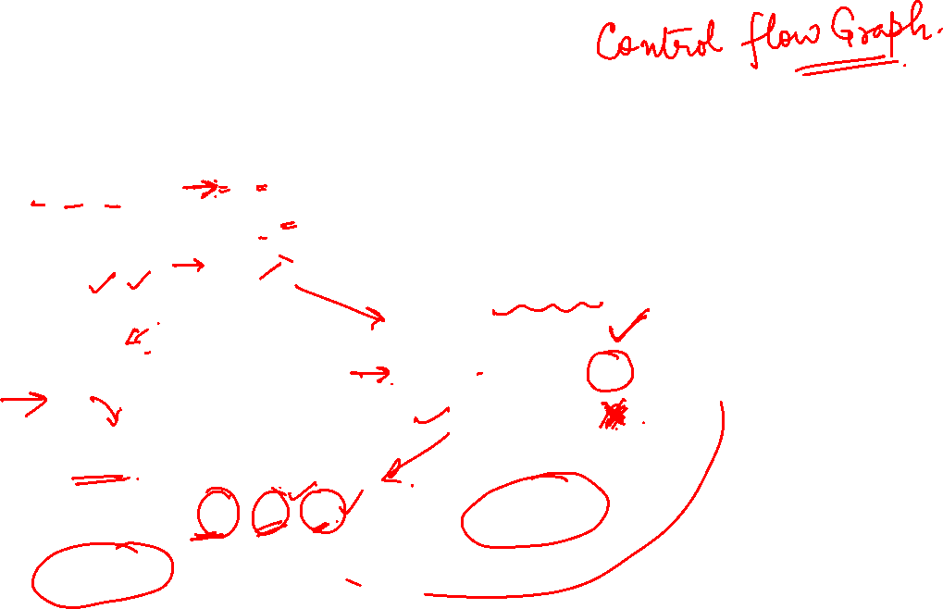
Graph Theory and its Applications
Register Allocation using Graph Coloring
Compute live variables for each point:

Slide 14
Graph Theory and its Applications Register Allocation using Graph Coloring
Register Interference Graph
2 temporaries that are live simultaneously cannot be allocated in the same register.
We construct an undirected graph
A node for each temporary
An edge between t1 and t2 if they are live simultaneously at some point in the program
This way the Register Interference Graph (RIG) is constructed.
Two temporaries can be allocated to the same register if there is no edge connecting them

Slide 15
Graph Theory and its Applications Register Allocation using Graph Coloring
Properties of Register Interference Graph
It extracts exactly the information needed to characterize legal register assignments
It gives a global (i.e., over the entire flow graph) picture of the register requirements
After RIG construction the register allocation algorithm is architecture independent
In our problem, colors = registers
We need to assign colors (registers) to graph nodes (temporaries)
Let k = number of machine registers
If the RIG is k-colorable then there is a register assignment that uses no more than k registers

Slide 16
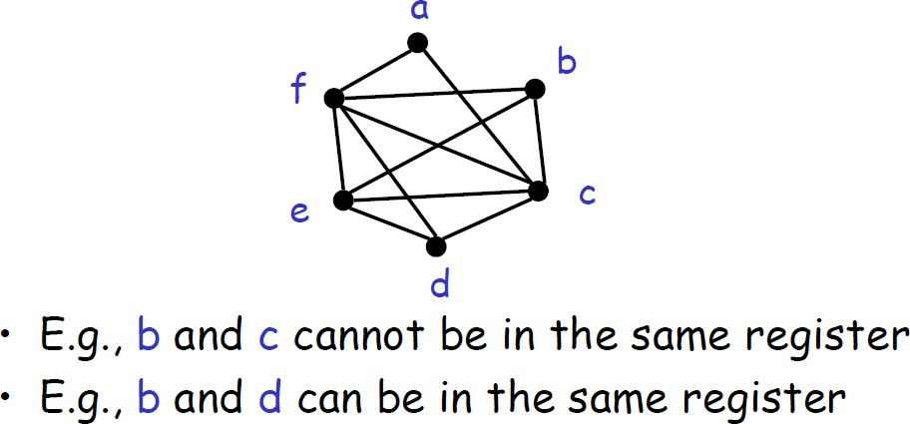
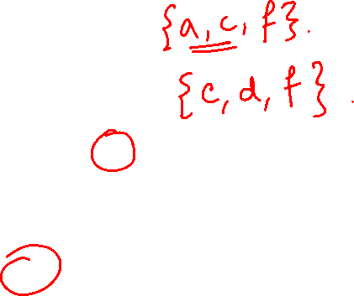
Graph Theory and its Applications Register Allocation using Graph Coloring
For our example

Slide 17
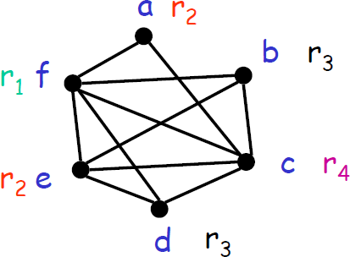
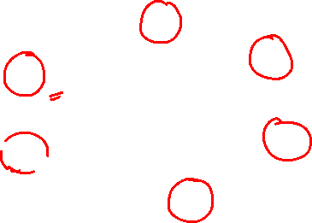
Graph Theory and its Applications Register Allocation using Graph Coloring
There is no coloring with less than 4 colors The graph is 4 colorable

Slide 18
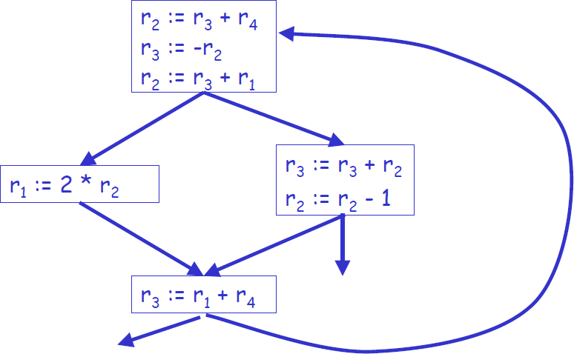
Graph Theory and its Applications Register Allocation using Graph Coloring

Slide 19
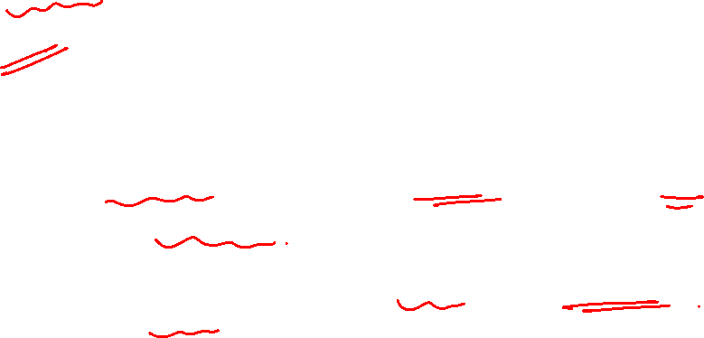
Graph Theory and its Applications Spilling
Suppose system architecture has 3 registers instead of 4 then the previous optimal coloring with 4 colors fail.
Then 3 temporaries will be allocated registers and the 4th temporary will be spilled to the main memory.
So we allocate a memory location in the main memory as the home of temporary ‘f’.
Typically this is in the current stack frame
Call this address where ‘f’ is stored as fa

Slide 20
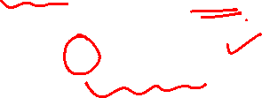
Graph Theory and its Applications Spilling
Whenever ‘f’ is to used in the code, we’ll insert a load instruction
f := load fa
And once its use is over, we can write it back to the memory address/location with
store f, fa

Slide 21
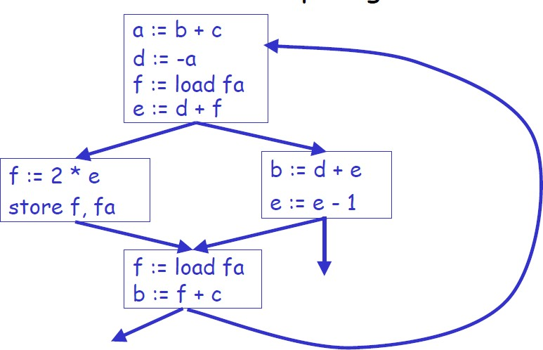
Graph Theory and its Applications Register Allocation using Graph Coloring

Slide 22
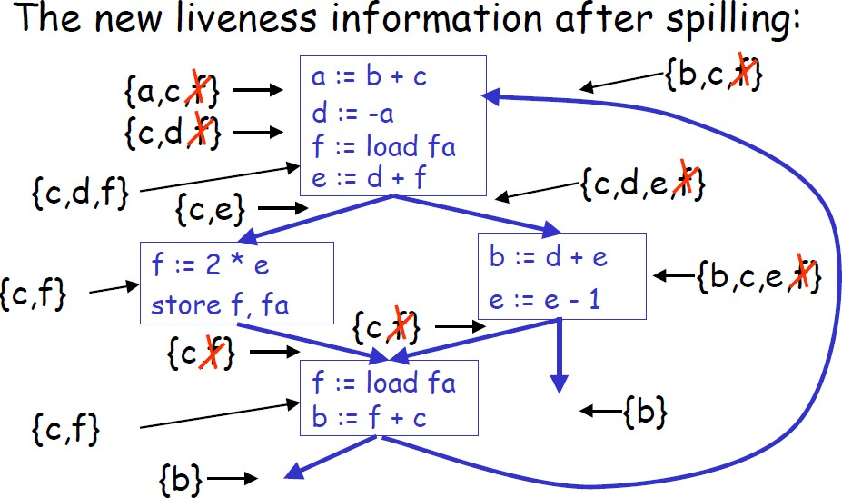
Graph Theory and its Applications Register Allocation using Graph Coloring
Pls note that ‘f’ is live only
Between a f := load fa and the next instruction.
Between a store f, fa and the preceding instruction.

Slide 23
Graph Theory and its Applications Register Allocation using Graph Coloring
The new liveness information is almost as before.
f is live only
Between a f := load fa and the next instruction.
Between a store f, fa and the preceding instruction.
Spilling reduces the life( live range) of f
And thus reduces the overall interferences.
As a result of this, RIG graph becomes simpler ( with fewer neighbors of f in RIG)

Slide 24
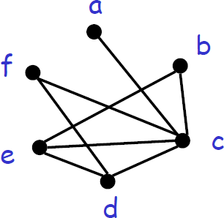
Graph Theory and its Applications Register Allocation using Graph Coloring
The only changes are in removing some of the edges of the spilled node
In our case f still interferes only with c and d
And the resulting RIG is 3-colorable
Now one more question arises:
What temporary to spill?
Possible ways or heuristics to resolve this:
Spill temporaries with most conflicts
Spill temporaries with few definitions and uses
Avoid spilling in inner loops

Slide 25
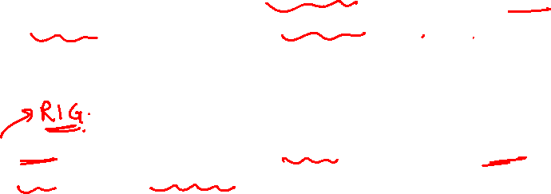
Graph Theory and its Applications Register Allocation using Graph Coloring
Chaitin's algorithm is a bottom-up, graph coloring register allocation algorithm that uses cost/degree as its spill metric.
It is named after its designer, Gregory Chaitin.
The graph is repeatedly examined and nodes with fewer than k neighbors are removed (where k is the number of colors we have to offer)

Slide 26
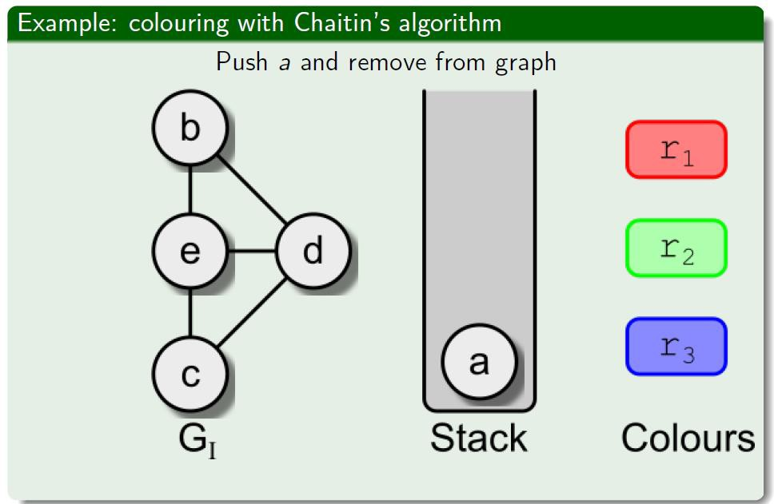
Graph Theory and its Applications Register Allocation using Graph Coloring

Slide 27
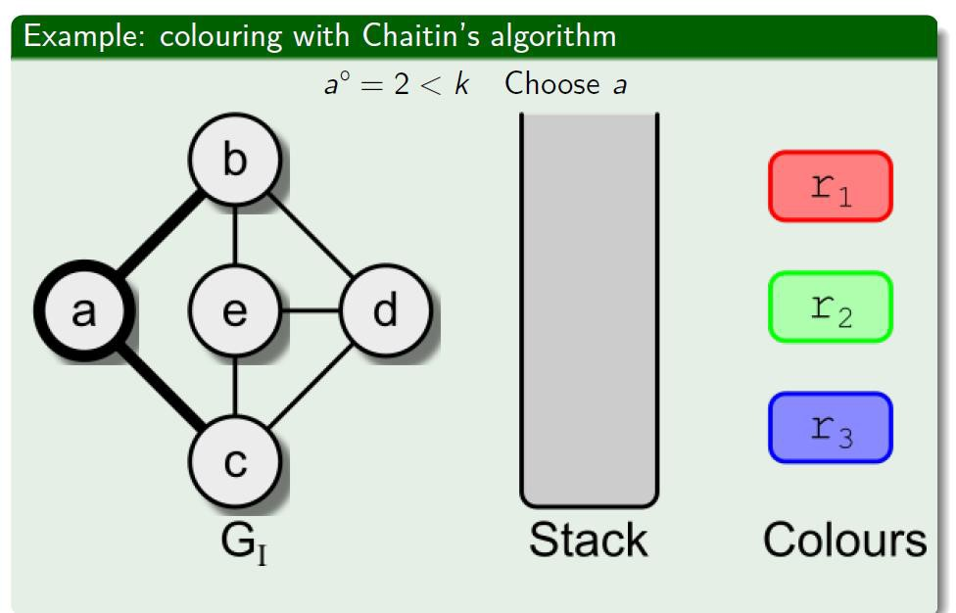
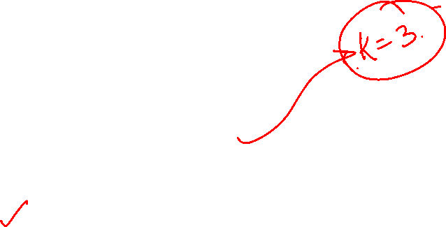
Graph Theory and its Applications Register Allocation using Graph Coloring

Slide 28
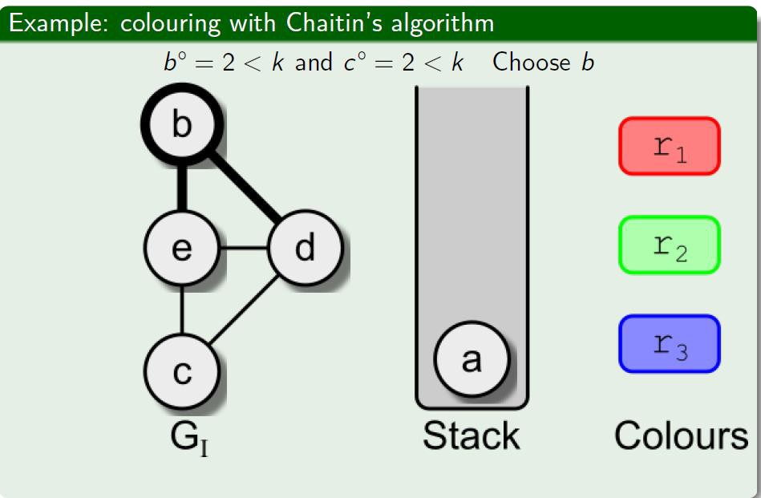
Graph Theory and its Applications Register Allocation using Graph Coloring

Slide 29
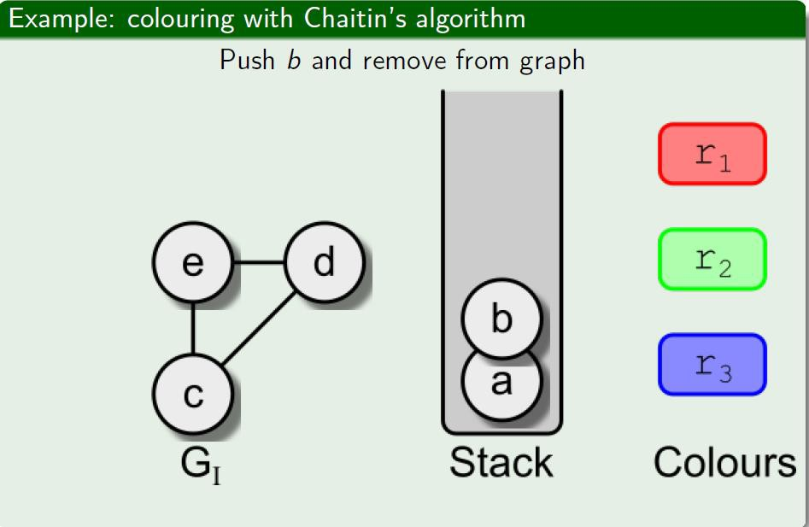
Graph Theory and its Applications Register Allocation using Graph Coloring

Slide 30
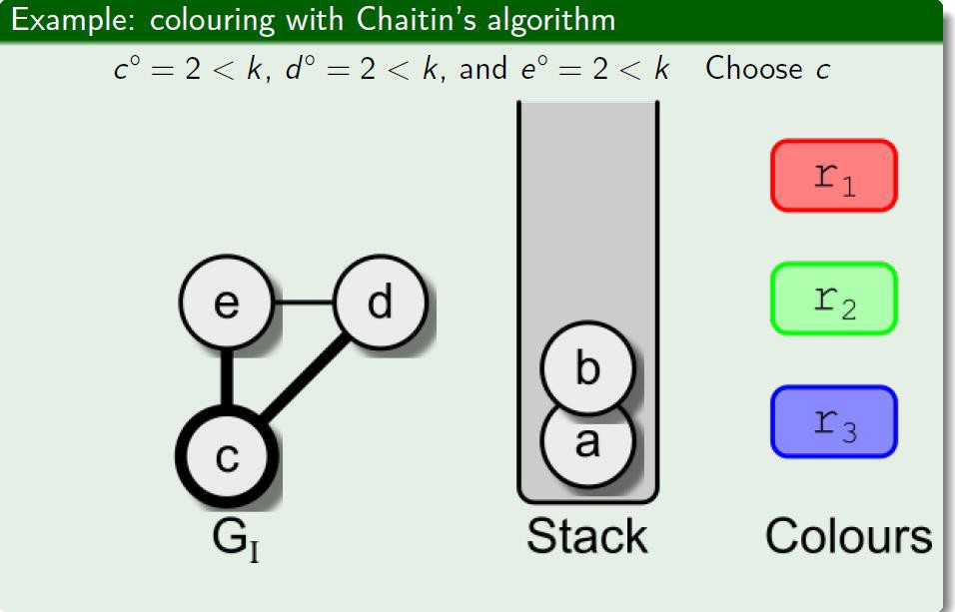
Graph Theory and its Applications Register Allocation using Graph Coloring

Slide 31
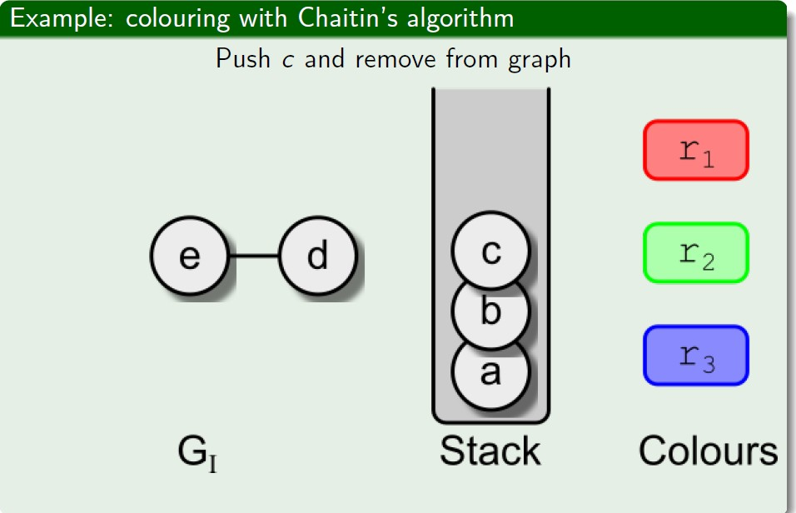
Graph Theory and its Applications Register Allocation using Graph Coloring

Slide 32
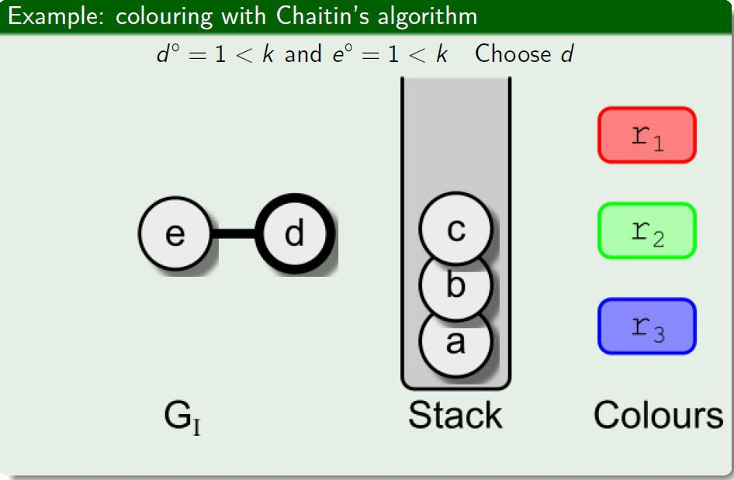
Graph Theory and its Applications Register Allocation using Graph Coloring

Slide 33
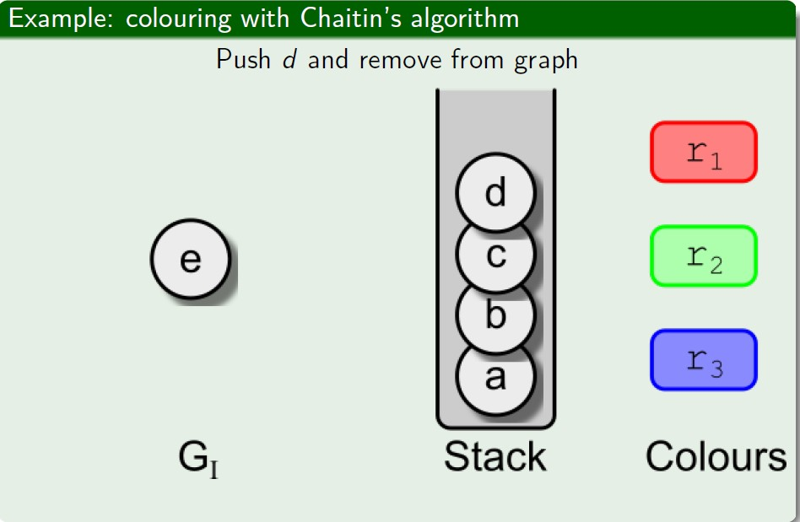
Graph Theory and its Applications Register Allocation using Graph Coloring

Slide 34
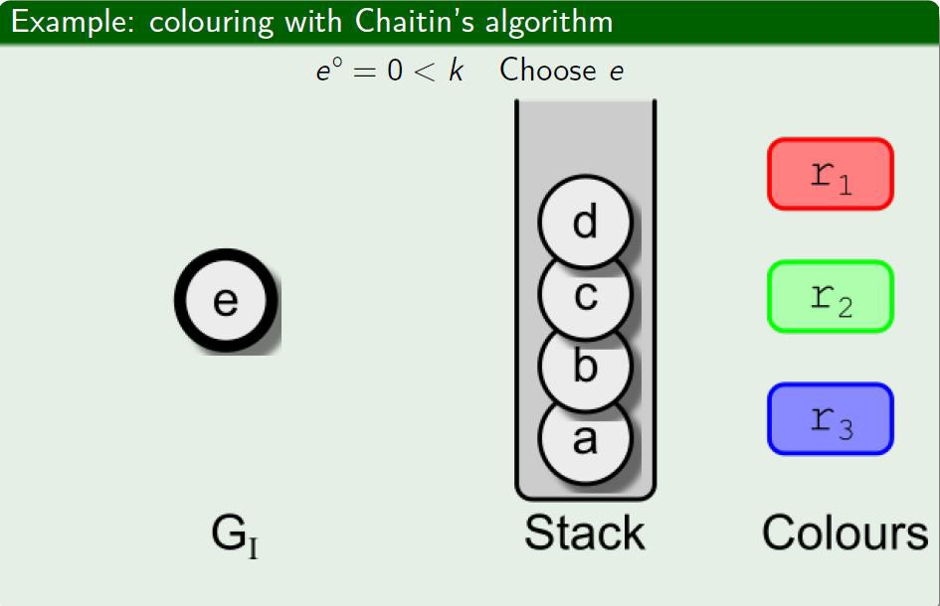
Graph Theory and its Applications Register Allocation using Graph Coloring

Slide 35
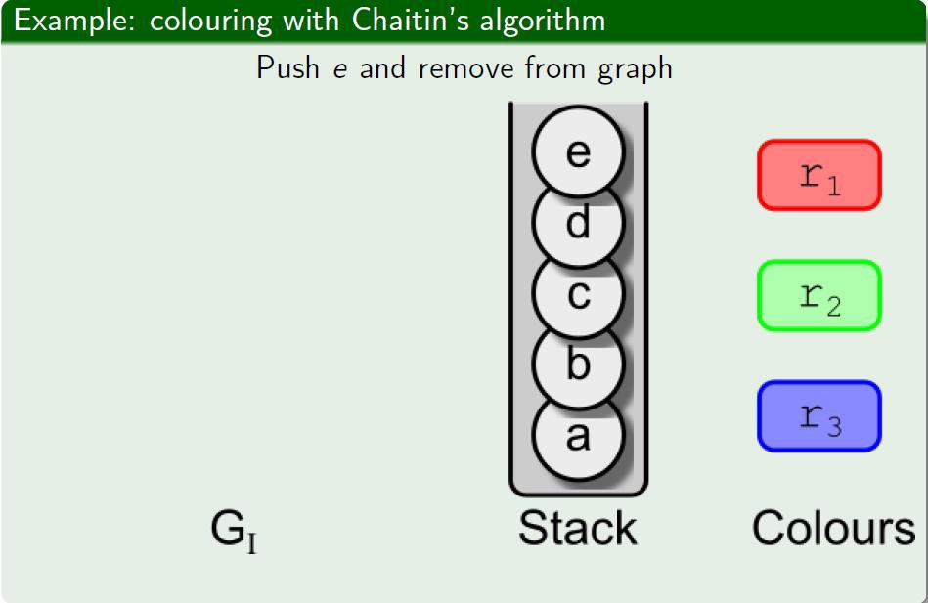
Graph Theory and its Applications Register Allocation using Graph Coloring

Slide 36
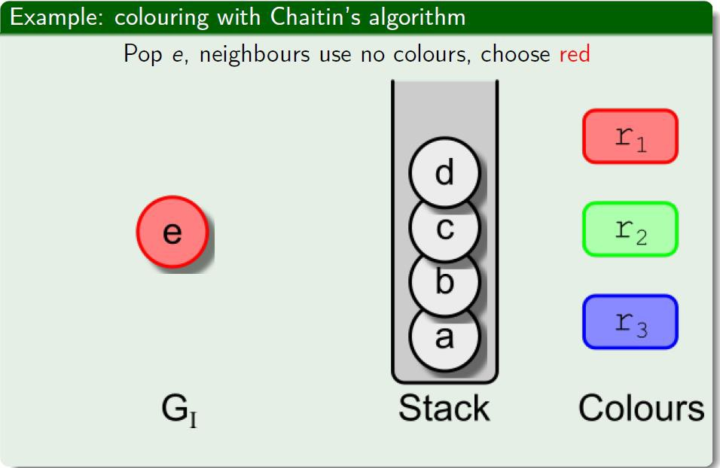
Graph Theory and its Applications Register Allocation using Graph Coloring

Slide 37
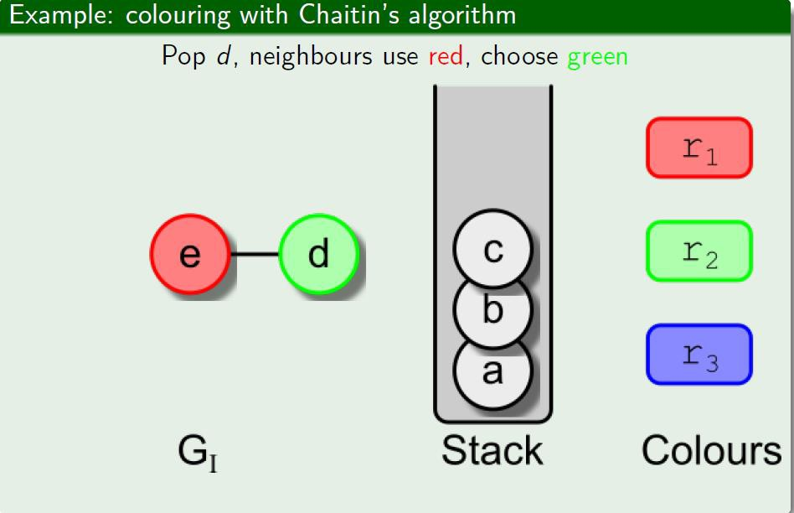
Graph Theory and its Applications Register Allocation using Graph Coloring

Slide 38
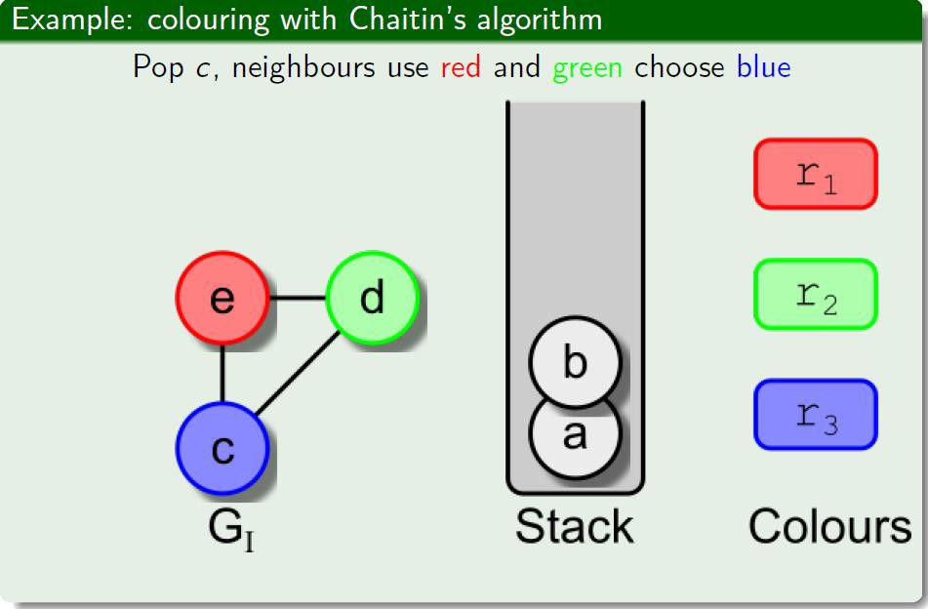
Graph Theory and its Applications Register Allocation using Graph Coloring

Slide 39
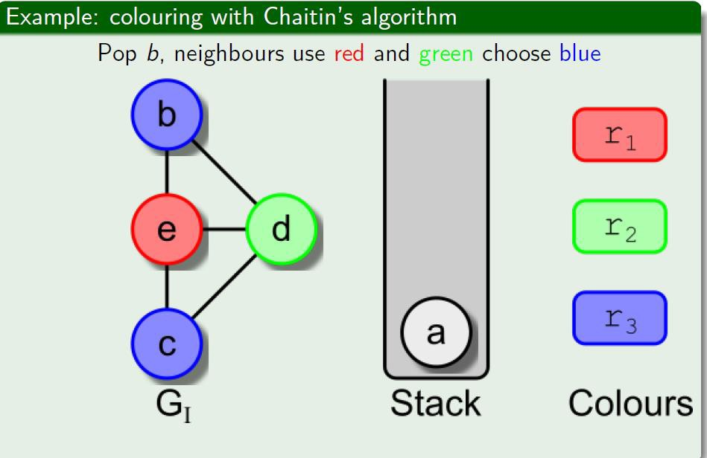
Graph Theory and its Applications Register Allocation using Graph Coloring

Slide 40
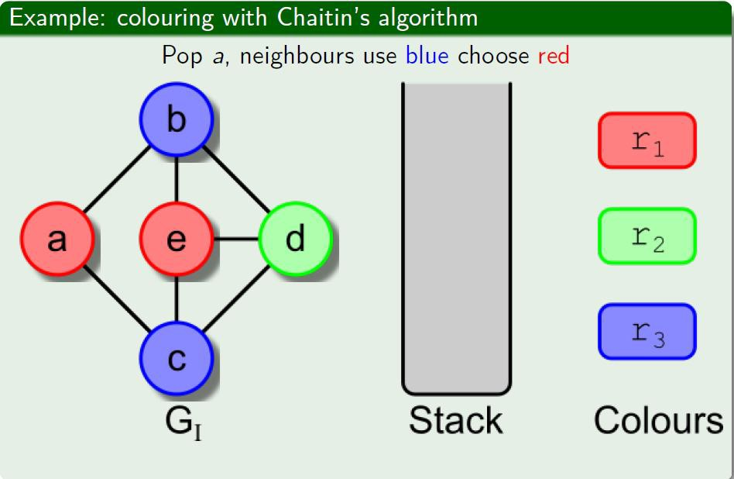
Register Allocation using Graph Coloring

Slide 41
THANK YOU
Dr. Arti Arya
Department of Computer Science &Engineering
artiarya@pes.edu

